Slide 1
Good Charts, Bad Charts

Slide 2
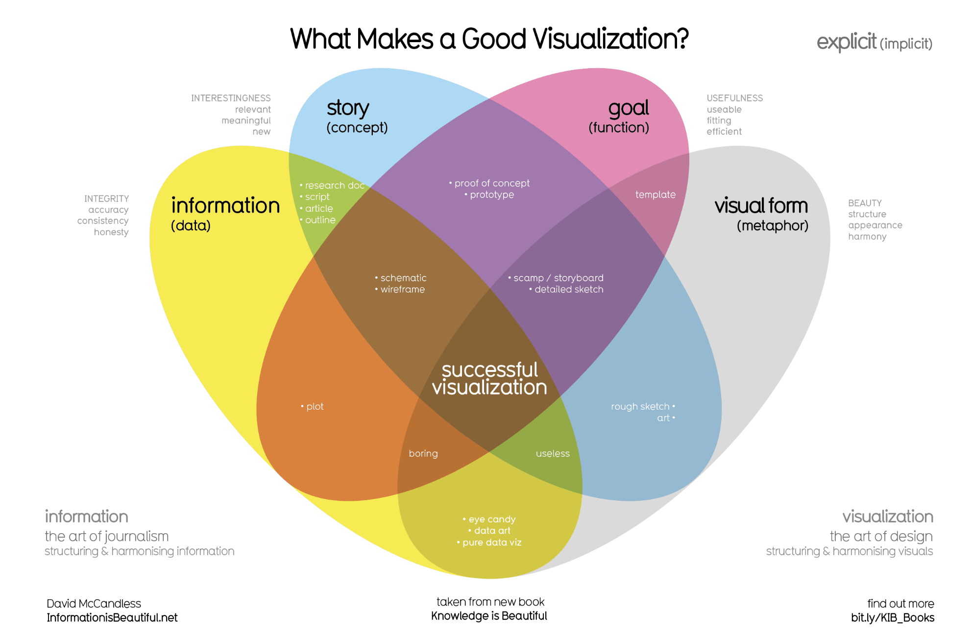

Slide 4
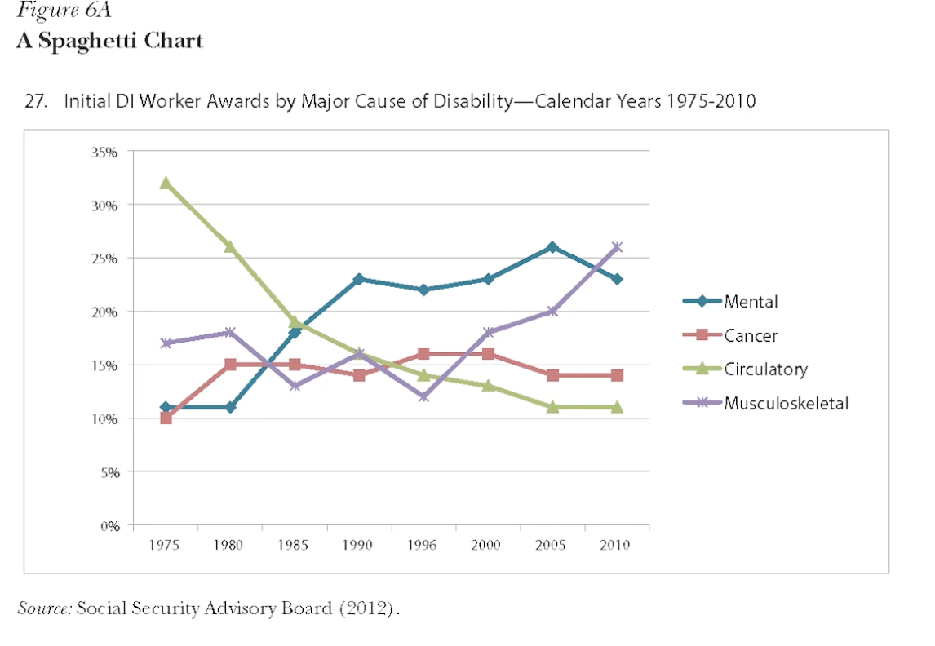
Color is enough to decode „causes“ on the legend

Slide 5
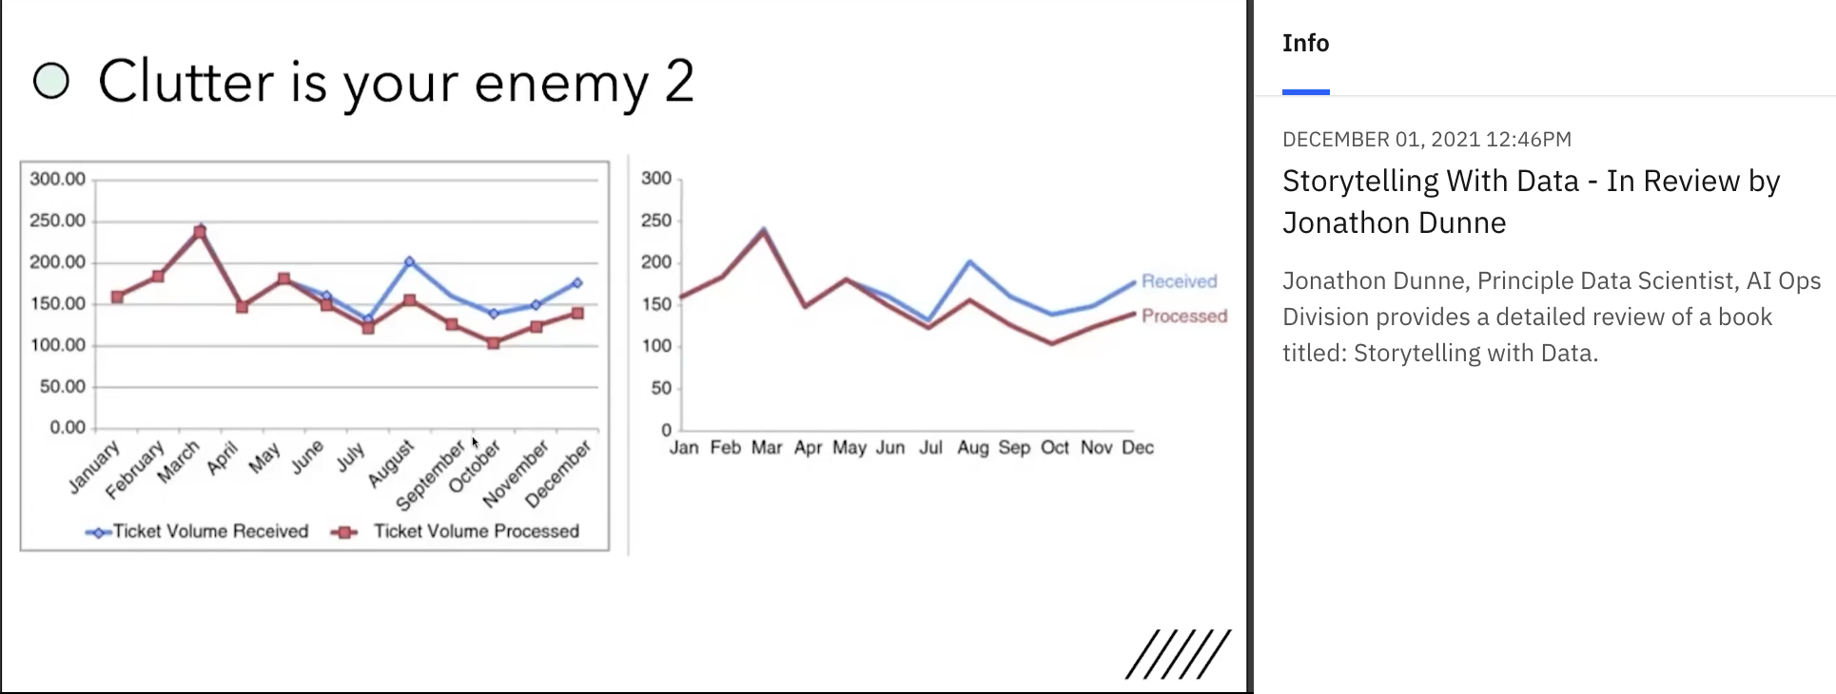
Legend, and text, near the elements

Slide 6
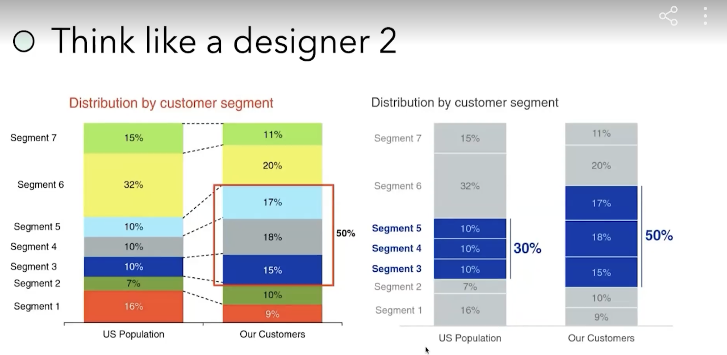

Slide 7
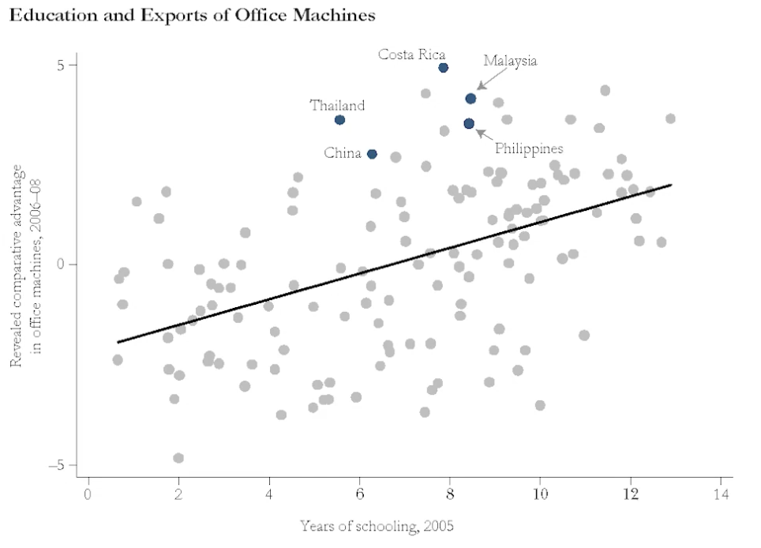
Explanatory Plots

Slide 8
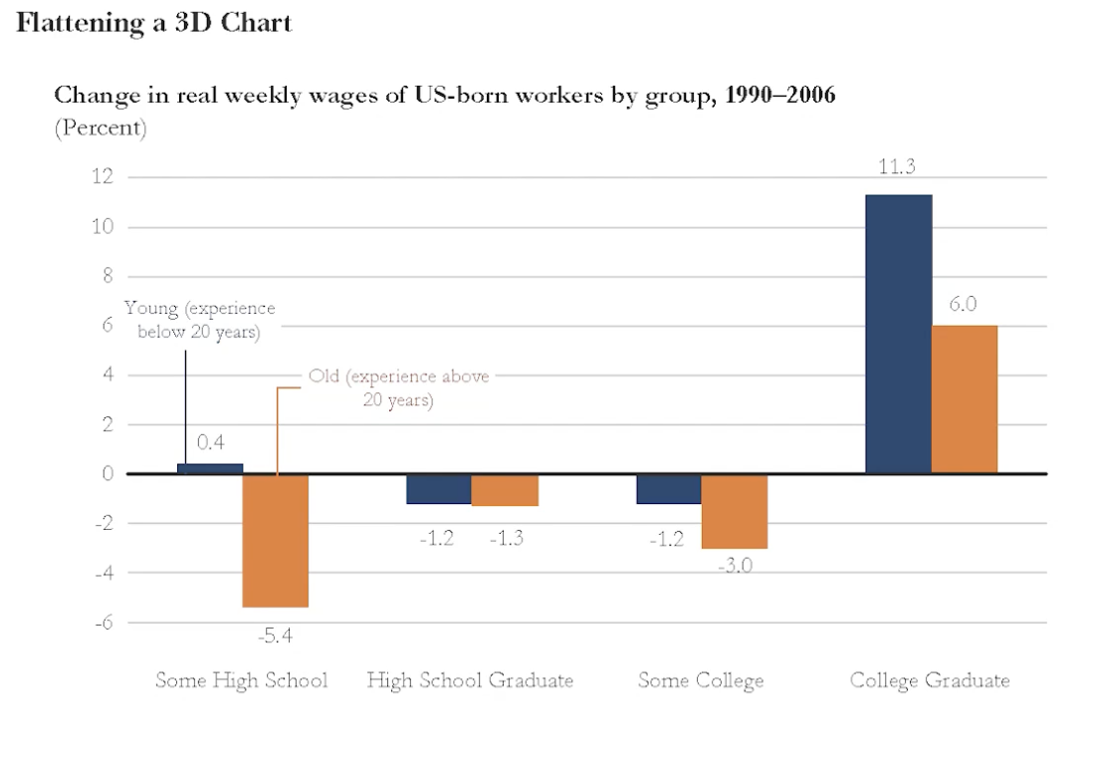
Grouped Bar Chart

Slide 9
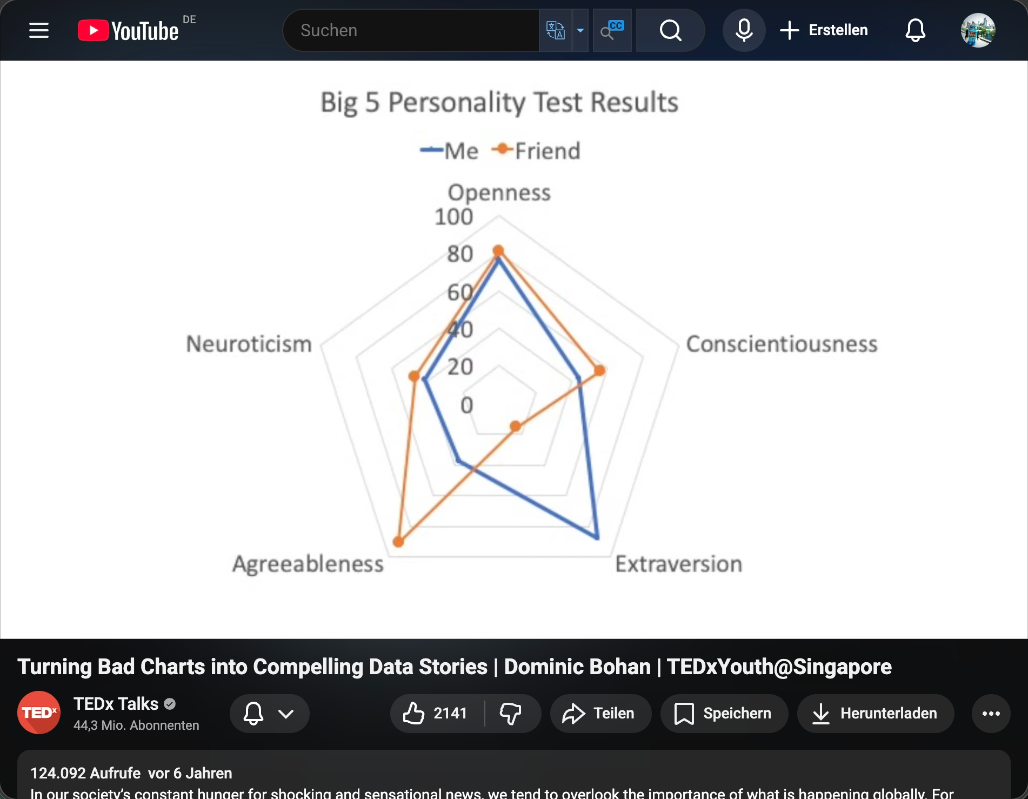
„Bad“

Slide 10
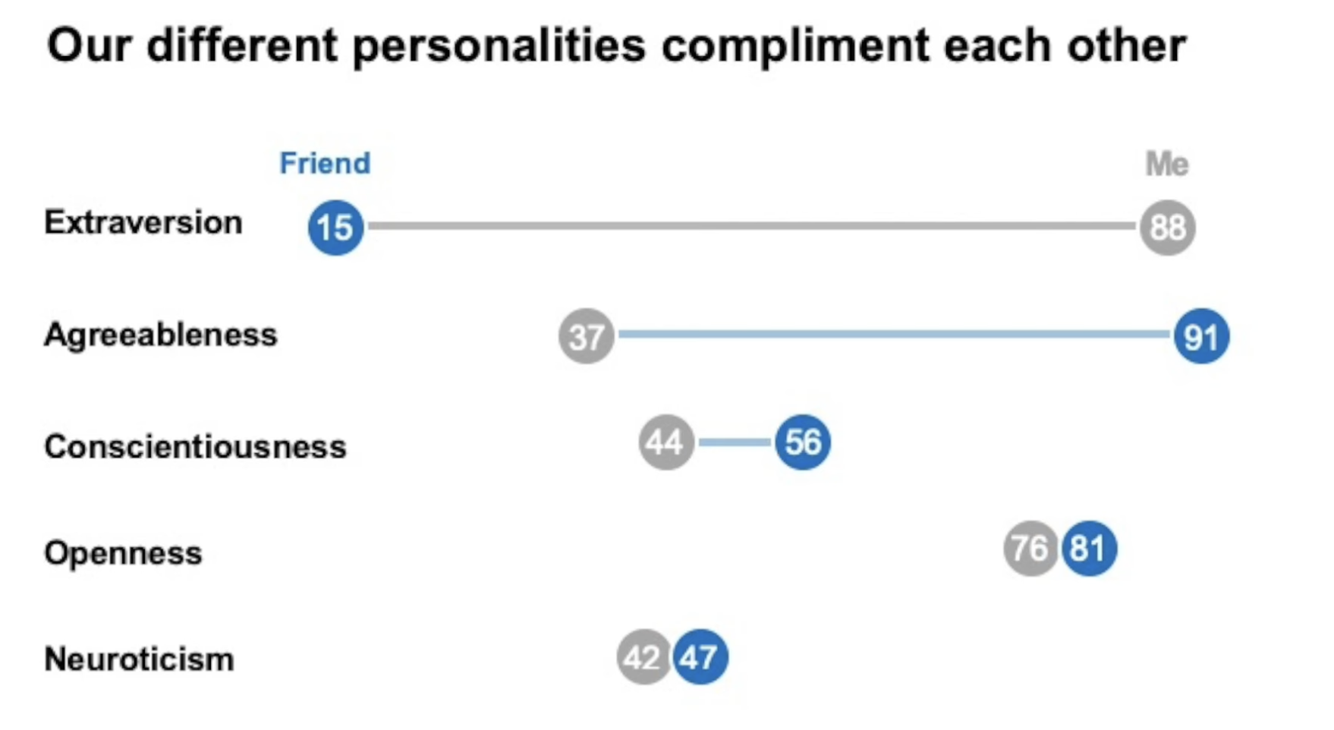
Better

